Slide 1
ImageNet-trained CNNs are biased towards texture; increasing shape bias improves accuracy and robustness Robert Geirhos, Claudio Michaelis, Patricia Rubisch, Felix A. Wichmann, Matthias Bethge, Wieland Brendel mainly University of Tübingen (& IMPRIS-IS)
Fabrice Beaumont Rheinische Friedrich-Wilhelms-Universität Bonn
30.09.2020

Slide 2
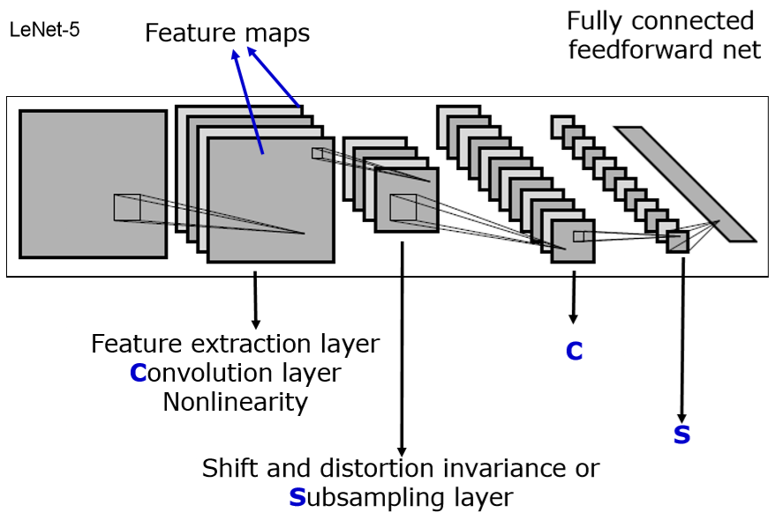
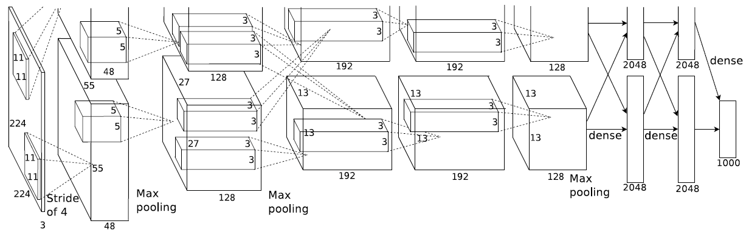
ImageNet-trained CNNs are biased towards texture; increasing shape bias improves accuracy and robustness )
2012 - Alex Krizhevsky et al. - AlexNet
Notes:
AlexNet
(KRIZHEVSKY, Alex; SUTSKEVER, Ilya; HINTON, Geoffrey E. Imagenet classification with deep convolutional neural networks. In: Advances in neural information processing systems. 2012. S. 1097-1105.)

Slide 3
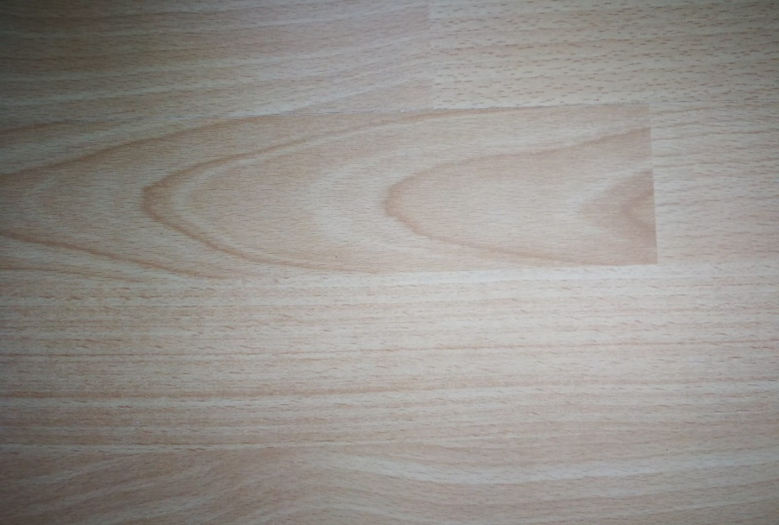
ImageNet-trained CNNs are biased towards texture; increasing shape bias improves accuracy and robustness )
2012 - Alex Krizhevsky et al. - AlexNet
Notes:
AlexNet
(KRIZHEVSKY, Alex; SUTSKEVER, Ilya; HINTON, Geoffrey E. Imagenet classification with deep convolutional neural networks. In: Advances in neural information processing systems. 2012. S. 1097-1105.)

Slide 4

ImageNet-trained CNNs are biased towards texture; increasing shape bias improves accuracy and robustness )
2012 - Alex Krizhevsky et al. - AlexNet
Notes:
AlexNet
(KRIZHEVSKY, Alex; SUTSKEVER, Ilya; HINTON, Geoffrey E. Imagenet classification with deep convolutional neural networks. In: Advances in neural information processing systems. 2012. S. 1097-1105.)

Slide 5
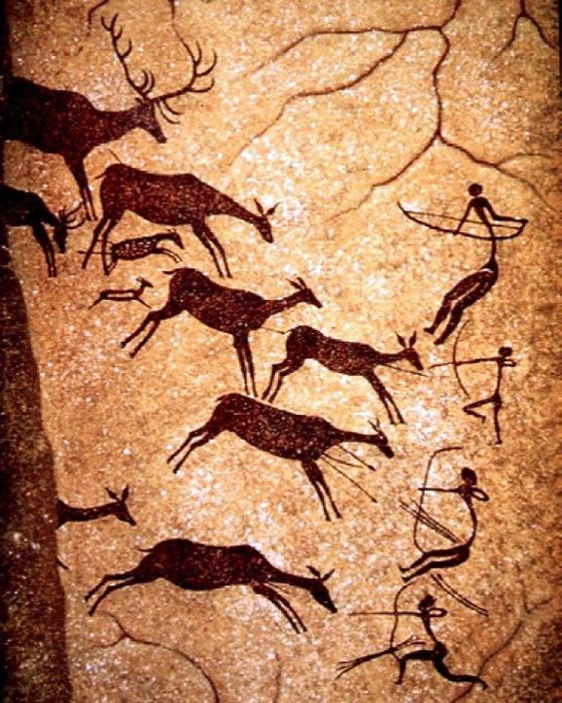
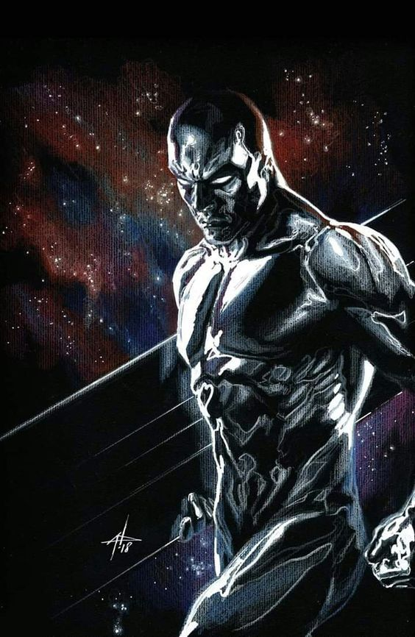
Motivation Importance of shape for object recognition
(2020; https://i.pinimg.com/564x/f5/bb/b4/f5bbb46820d7d3b9f41753f24db74516.jpg)
(2020; https://i.pinimg.com/564x/8e/34/f5/8e34f51699073da82c11d9995699498f.jpg)
1 / 26

Slide 6
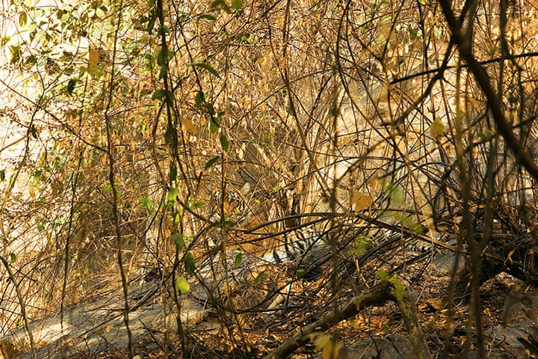
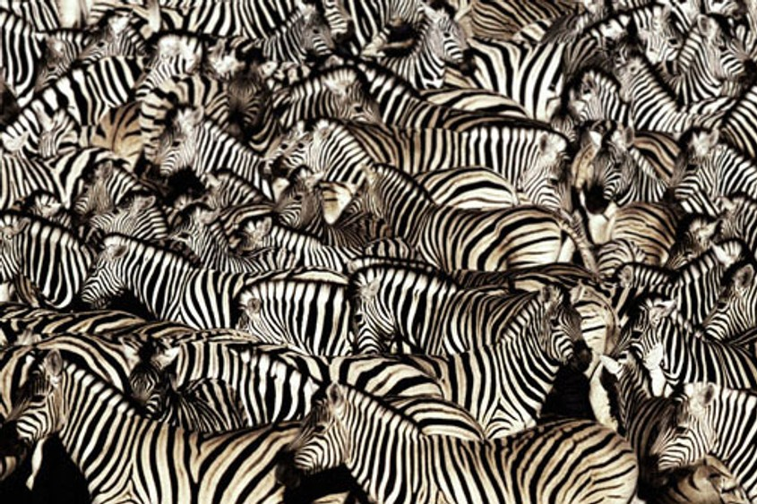
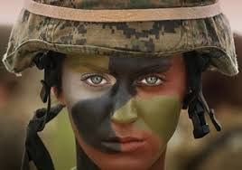
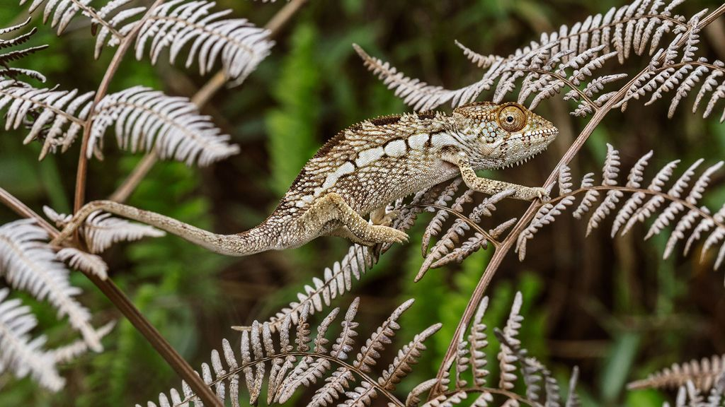
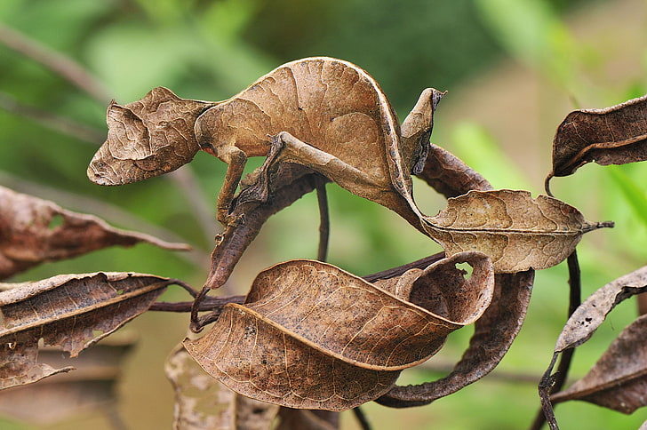
Motivation Importance of shape for object recognition
(2020; https://www.economist.com/img/b/1000/563/90/sites/default/files/images/print-edition/20120211_STP002_0.jpg)
(2020; https://i.redd.it/gmvyk1pz26p21.jpg)
(2020; https://i.pinimg.com/564x/84/e1/ 24/84e1240ca1d519a479310f24cc6a41e7.jpg)
(2020; https://static.nationalgeographic.de/files/styles/image_3200/public/chameleons-color-emotion-nationalgeographic_2298709.jpg?w=1024&h=576)
(2020; https://p4.wallpaperbetter.com/wallpaper/606/752/970/animals-reptiles-gecko-camouflage-wallpaper-preview.jpg)
1 / 26

Slide 7
Motivation
Humans (and other animals) excel at recognizing objects via their shape!
(Landau et al., 1988)
...But what about machines (here: CNNs)?
shape
texture
1 / 26

Slide 8
Introduction
SHAPE hypothesis: | CNNs learn to recognize and classify shapes
Support: | Zeiler & Fergus, 2014 Ritter et al., 2017 (contradicted by Hosseini et al. 2018)
“CNNs are ‘currently’ the most predictive model for human vental stream object recognition”
 | Landau et al., 1988 Cadieu et al., 2014 and Yamins et al., 2014 Kubilius et al., 2016
TODO/Note: (offer to) explain the supporting contributions verbally
1 / 26

Slide 9
Introduction
TEXTURE hypothesis: | CNNs learn to recognize and classify textures
Support: | Gatys et al., 2015 Gatys et al., 2016 Gatys et al., 2017 and Brendel & Bethge, 2019 Ballester & de Aruújo, 2016 Eckstein et al., 2017 Wollis et al., 2017 and Laskar et al., 2018 and Long & Konkle, 2018 Funke et al., 2017 Geirhos et al., 2018 Gondal et al., 2018 Gokaslan et al., 2018 Brendel & Bethge, 2019
TODO/Note: (offer to) explain the supporting contributions verbally
1 / 26
Notes:
- It is sufficient to use many local texture features (rather than global shapes) for training purpose

Slide 10

Task(s)
TASK: Elaborate what exactly a CNN does learn –
if the ImageNet database is used
Result: 1. The CNN did learn (mostly) use textures for the classification task
Subtask: Can and should this texture-biased learning be avoided?
Solution: 2. Yes it can be avoided by using a modified database
3. Avoiding it this way leads to an improved method
SHAPE
TEXTURE
1 / 26

Slide 11
Method
Terminology
DEF: feature = attribute learned by CNN
DEF: cue = physical attribute
Idea: Assume that both CNN and humans rely on shape (shape being a feature and a cue). Now present images with clear shapes but a contradicting cue (in this case texture).
→ Use texture-shape cue conflicts
1 / 26
Notes:
If performance of CNNs is BAD: Shape is not an important feature (because it is still detectable)
If performance of CNNs/human is GOOD: The contradicting cue is not an important feature - because the detectable shape was sufficient for the classification.
Quantify the texture & shape biases in humans & CNN

Slide 12
Method
DEF: texture-shape cue conflict:
“style-transfer“
(Gatys et al., 2016)
(Geirhos et al., 2029)
1 / 26

Slide 13
Experiments Setup
48 560 trials, 97 humans
Following the paradigm for comparability of human & machine experiments (by Geishos et al., 2018)
Only use images which where sampled correctly by the CNN
13 / 26

Slide 14
Experiments Setup
Fixation square
300 ms
13 / 26
https://en.wikipedia.org/wiki/Pink_noise#/media/File:Noise.jpg

Slide 15

Experiments Setup
300 ms
Stimulus image
300 ms
13 / 26
https://en.wikipedia.org/wiki/Pink_noise#/media/File:Noise.jpg

Slide 16
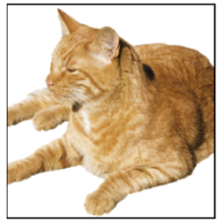
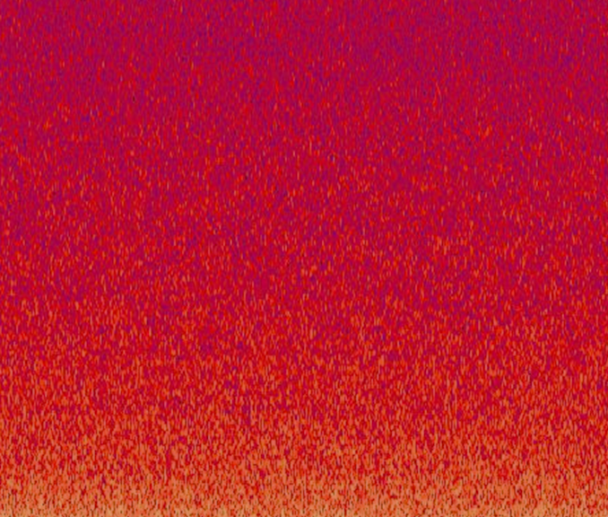
Experiments Setup
300 ms
300 ms
Full-contrast pink noise mask
200 ms
Goal: minimize feedback processing in the human visual system
13 / 26
https://en.wikipedia.org/wiki/Pink_noise#/media/File:Noise.jpg
Notes:
- Minimization of the feedback processing because the CNN is also „just feed-forward“

Slide 17
Experiments Setup
300 ms
300 ms
200 ms
Click at the corresponding category “Guess if unsure“
1500 ms
The categories are known and represented by pictograms
13 / 26
https://en.wikipedia.org/wiki/Pink_noise#/media/File:Noise.jpg

Slide 18
Experiments Setup
300 ms
300 ms
200 ms
1500 ms =1.5 sec!!
airplane | bear | bicycle | bird
boat | bottle | car | cat
chair | clock | dog | elephant
keyboard | knife | oven | truck
= 16-class-ImageNet (Geirhos et al., 2018)
13 / 26
https://en.wikipedia.org/wiki/Pink_noise#/media/File:Noise.jpg

Slide 19
Experiments Setup
AlexNet (Krizhevsky et al., 2012)
GoogLeNet (Szegedy et al., 2015)
VGG-16 (Simonyan & Zisserman, 2015)
ResNet-50 (He et al., 2015)
vs
“WordNet hierarchy“
(Miller, 1995)
13 / 26
https://en.wikipedia.org/wiki/Pink_noise#/media/File:Noise.jpg

Slide 20
Experiments Setup
9 Experiments:
13 / 26
Notes:
9 Experiments (PIE CHART?)
6 major
5: object recognition, different available features (Figure 2)
1: Cue conflices (Figure 1, S. 4)
3 control

Slide 21
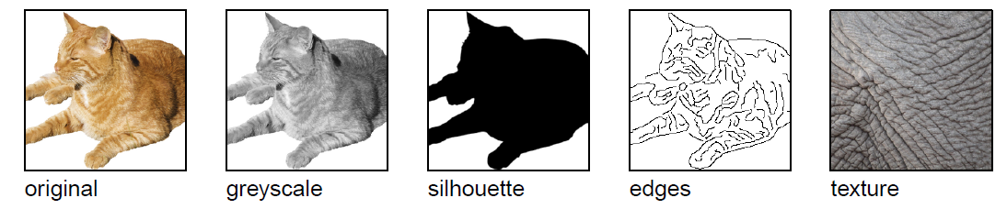
Experiments Setup
x160
x160
x160
x160
x48
Original
Greyscale
Silhouette
Object shape
Texture
(Geirhos et al., 2029)
13 / 26
Notes:
Original: natural colour images, white background (160 images = 10 per one of the 16 categories)
Greyscale: (skimage.color.rgb2gray)
Silhouette: convert to .bmp (command line), convert to .svg (using potrace), convert to .png (command line) + manually checking every image and correcting using GIMP if necessary
Object shape: edge based representation/ describe 3D contours (Canny edge extractor (MATLAB))
Texture: 48 natural colour images of textures (3 per one of the 16 categories) – „full-width patches of animal (skin, fur) or repeted man-mad objects“ (e.g. Bottles see top slides)

Slide 22
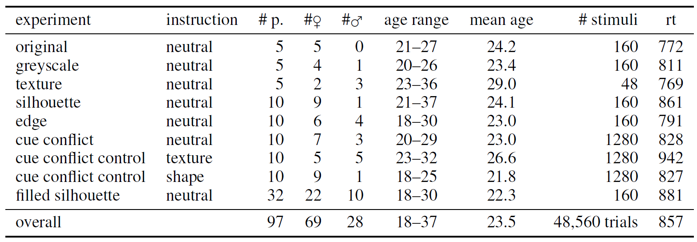
Experiments Setup
TODO: Decide if useful (write to table, rename “edge” and
Rearange rows)
13 / 26

Slide 23
5 Experimental evaluation
BOTH
BOTH
HUMANS
HUMANS
BOTH
x160
x160
x160
x160
x48
Original
Greyscale
Silhouette
Object shape
Texture
→ The CNNs had problems to shift from natural images (training data) to sketches (“silhouette“, “object shape“)
(Geirhos et al., 2029)
13 / 26

Slide 24
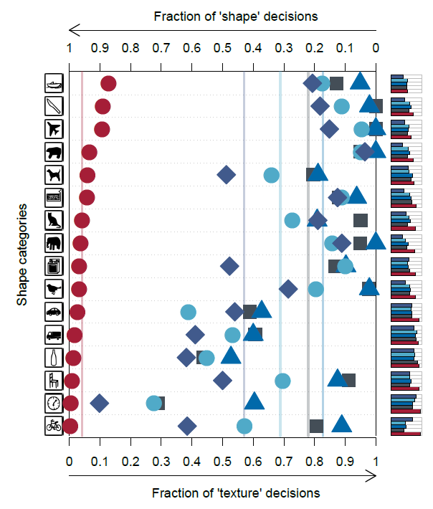
Experiments Setup
cat
x1280
elephant
13 / 26

Slide 25
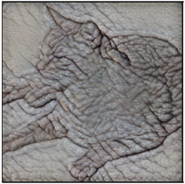
Experiments Setup
x160
x160
x160
x160
x48
Original
Greyscale
Silhouette
Object shape
Texture
Texture-shape cue conflict
(Geirhos et al., 2029)
13 / 26

Slide 26
5 Experimental evaluation
BOTH
BOTH
HUMANS
HUMANS
BOTH
HUMANS
x160
x160
x160
x160
x48
Original
Greyscale
Silhouette
Object shape
Texture
Texture-shape cue conflict
1. Result: The CNNs used textures for the classification task.
They have problems to shift from natural images (training data) to sketches
(Geirhos et al., 2029)
13 / 26

Slide 27
5 Experimental evaluation → RESULT 1
The texture hypothesis holds: CNNs tend to learn to recognize texture rather than shape
13 / 26
Notes:
Texture-bias is NOT by design of the CNN
3. ⬅ p.9 Dodge & Karam, 2017, Geiros et. Al. 2017/2018
⬅ as shown there was support given
Entriely „New“ (? Is that so??)

Slide 28

5 Experimental set-up ImageNet
WordNet hierarchy
100.000 synsets
Average of over 500 images / node
(2020; http://www.image-net.org; snapshot)
13 / 26
Notes:
WordNet = lexical database of English (Princeton University)

Slide 29
5 Experimental evaluation
Idea: SIN – Stylized ImageNet
- Replace original texture with a randomly selected painting (through AdaIN style transfer – Huang & Belongie, 2017) (Kaggle‘s “Painter by Numbers“ data set, 79.434 paintings)
(Geirhos et al., 2029)
13 / 26
Notes:
Texture-bias is NOT by design of the CNN
3. ⬅ p.9 Dodge & Karam, 2017, Geiros et. Al. 2017/2018
⬅ as shown there was support given
Entriely „New“ (? Is that so??)
Why not use Gatys stlye transfer? 1. use different stylization techniques, 2. Enable stylizing the entrie ImageNet (Gatys method is iterative and thus slower)
(Code to create SIN is avaliable on github.)

Slide 30
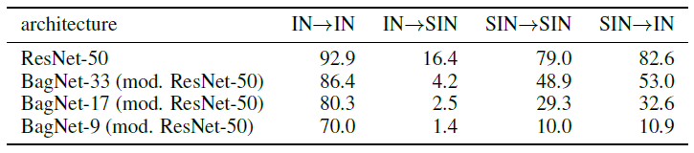
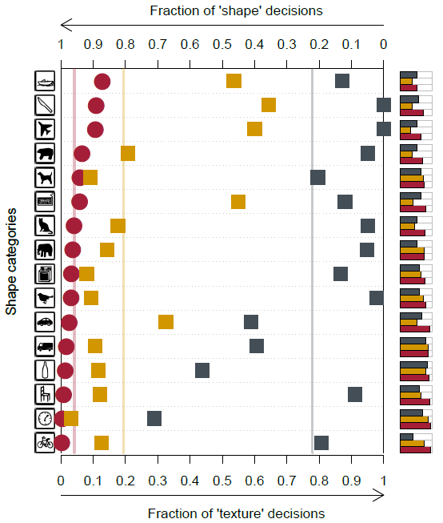
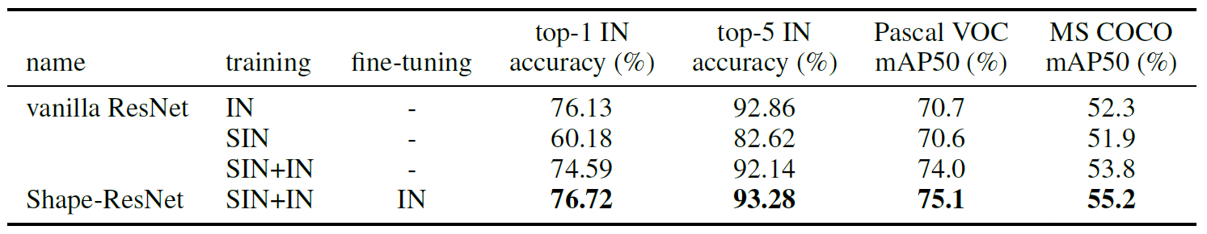
5 Experimental evaluation
TODO: Figure 6,
Table 1 and 2
Texture-shape Cue Conflict: human (shape), CNN (texture) (substantial fraction of difficulties = “hard problem”
(Geirhos et al., 2029)
26 / 26

Slide 31
5 Experimental evaluation → RESULT 1
The texture hypothesis holds: CNNs tend to learn to recognize texture rather than shape
13 / 26
Notes:
Texture-bias is NOT by design of the CNN
3. ⬅ p.9 Dodge & Karam, 2017, Geiros et. Al. 2017/2018
⬅ as shown there was support given
Entriely „New“ (? Is that so??)

Slide 32
5 Experimental evaluation → RESULT 1, 2 and 3
The texture hypothesis holds: Classifing objects by textures is easier (but less robust) than classifing them by shape – thus CNNs tend to learn to recognize texture
The texture-bias of CNNs is induced by the training setup (data) and thus can be cured and changed towards a shape-bias
CNNs trained with a shape-bias are more
robust to distortion
Performant (with respect to classification and object recognition)
13 / 26
Notes:
Texture-bias is NOT by design of the CNN
3. ⬅ p.9 Dodge & Karam, 2017, Geiros et. Al. 2017/2018
⬅ as shown there was support given
Entriely „New“ (? Is that so??)

Slide 33
Conclusion
The texture hypothesis holds: Classifing objects by textures is easier (but less robust) than classifing them by shape – thus CNNs tend to learn to recognize texture
The texture-bias of CNNs is induced by the training setup (data) and thus can be cured and changed towards a shape-bias
CNNs trained with a shape-bias are more
robust to distortion
Performant (with respect to classification and object recognition)
13 / 26
Notes:
Texture-bias is NOT by design of the CNN
3. ⬅ p.9 Dodge & Karam, 2017, Geiros et. Al. 2017/2018
⬅ as shown there was support given
Entriely „New“ (? Is that so??)

Slide 34
Experiments Setup
TODO
(Geirhos et al., 2029)
13 / 26

Slide 35
Thank you for your attention!

Slide 36
Appendix Other slides

Slide 37
5 Experimental evaluation
26 / 26

Slide 38
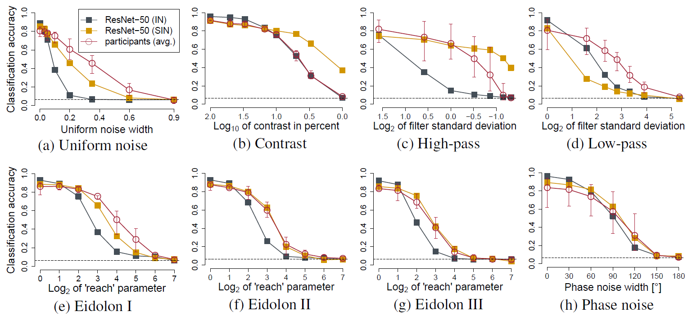
5 Experimental evaluation
26 / 26

Slide 39
Introduction
SHAPE hypothesis: | CNNs learn to recognize and classify shapes
Support: | object parts in high-level CNN features shape bias (shape over colour) (contradicted by Hosseini et al. 2018)
“CNNs are ‘currently’ the most predictive model for human vental stream object recognition”
 | shape is most important cue for humans model for human vental stream computational morel of human shape perception
1 / 26

Slide 40
Introduction
TEXTURE hypothesis: | CNNs learn to recognize and classify textures
Support: | performance: with linear classifier on top of texture representation (Gram matrix) performance: when global shape is destroyed performance: when texture cues are missing performance: with varying object size w.r.t. context performance: static and dynamic texture synthesis performance: varying object dimensions (colour) performance: varying resolution … TODO Gokaslan … TODO performance: constrained receptive field size CNN match texture appearance for humans
Performance: texture-based generative modelling approaches
Performance: shape transfer
1 / 26
Notes:
It is sufficient to use many local texture features (rather than global shapes) for training purpose
-texture-based generative modelling approaches such as style transfer (Gatys et al., 2016), single
image super-resolution (Gondal et al., 2018) as well as static and dynamic texture synthesis (Gatys
et al., 2015; Funke et al., 2017) all produce excellent results using standard CNNs, while CNNbased
shape transfer seems to be very difficult (Gokaslan et al., 2018).

Slide 41
Method
Terminology
DEF: feature = attribute learned by CNN
DEF: cue = physical attribute
Idea: Reduce the the relation of present textures with the solution – for testing and or training (If the performance of the CNNs drops but not the performance of the human, this could indicate that the CNN classify using a different approach. Quantify the texture & shape biases in human & CNN)
Use texture-cure conflics
1 / 26

Slide 42
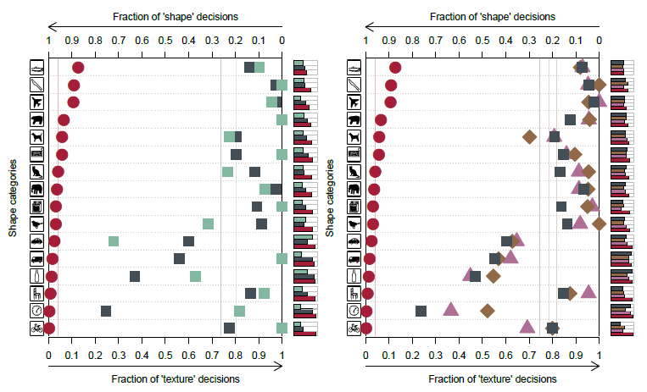
5 Experimental evaluation
TODO: Figure 1, 2, 4
Both good: natural, greyscale, texture
CNN bad: silhouette, edges (= “object shape”) ➔ CNNS difficulties from natural to sketch
26 / 26

Slide 43
ImageNet-trained CNNs are biased towards texture; increasing shape bias improves accuracy and robustness )
1995 by Yann LeCun and Yoshua Bengio
Notes:
AlexNet
(KRIZHEVSKY, Alex; SUTSKEVER, Ilya; HINTON, Geoffrey E. Imagenet classification with deep convolutional neural networks. In: Advances in neural information processing systems. 2012. S. 1097-1105.)

